Slide 1
Electrical
and Electronics science
First year
Computer Science and Engineering
Dr. Shakti Singh
ASSISTANT PROFESSOR
ELECTRCIAL AND INSTRUMENATION
ENGINEERING DEPARTMENT
@shakti.singh@thapar.edu

Slide 2
Applications of Op Amp
Voltage follower
Summing and Difference Amplifier
Integrator, Differentiator
Phase Shifter
V to I converter
Scale changer
Logarithmic amplifier
Peak detector
Voltage comparator
Noise Suppressor

Slide 3
Ideal Op Amp

Slide 4
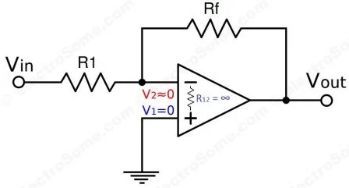
Virtual Ground Concept
In Op-Amps the term virtual ground means that the voltage at that particular node is almost equal to ground voltage (0V). It is not physically connected to ground.
This concept is very useful in analysis of Op-Amp circuits and it will make a lot of calculations very simple.

Slide 5
Virtual Ground Concept
Virtual Ground concept is very useful in analysis of an Op-Amp when negative feedback is employed. It will simply a lot of calculations and derivations.
An ideal Op-Amp will provide infinite voltage gain. For real Op-Amps also the gain will be very high.
Gain = Vo/Vin
As gain is infinite, Vin = 0
Vin = V2 – V1
In the previous circuit V1 is connected to ground, so V1 = 0. Thus V2 also will be at ground potential.
V2 = 0

Slide 6
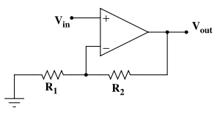

Non-inverting Op-Amp
www.wikipedia.org
Uses: Amplify…straight up

Slide 8
Voltage follower

Slide 9
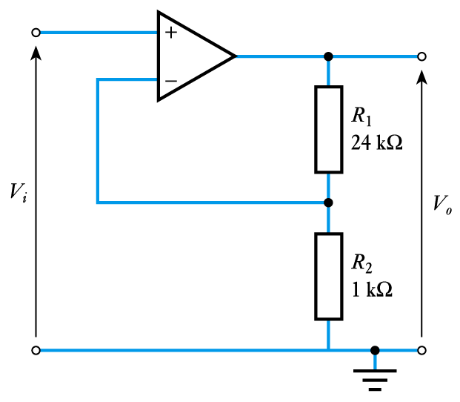
Example Design a non-inverting amplifier with a gain of 25
From above
If G = 25 then
Therefore choose R₂ = 1 kΩ and R₁ = 24 kΩ

Slide 10
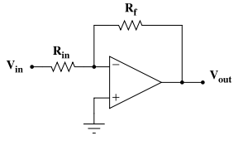
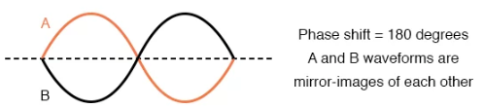
Inverting Op-Amp
www.wikipedia.org
Uses: Analog inverter

Slide 11
Find output voltage in figure, also find current through 10 kOhm resistor

Slide 12
Find output voltage In figure

